Slide 1

Computer Networks LAB
LAB # 2
Configuration of Local Area Network using Packet Tracer
Department of Computer Science & Information Technology
IQRA UNIVERSITY, ISLAMABAD CAMPUS

Slide 2

IP Address & Subnet mask
Classes | IP Address | Subnet mask
Class A | 0-126 | 255.0.0.0
Class B | 128-191 | 255.255.0.0
Class C | 192-223 | 255.255.255.0
Class D | 224-239 | N/A
Class E | 240-255 | N/A

Slide 3
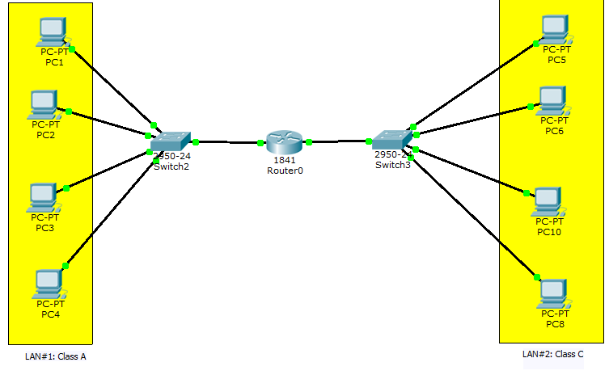

Slide 4
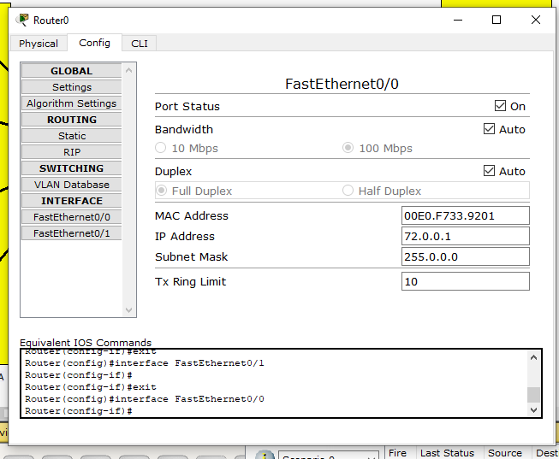

Slide 5
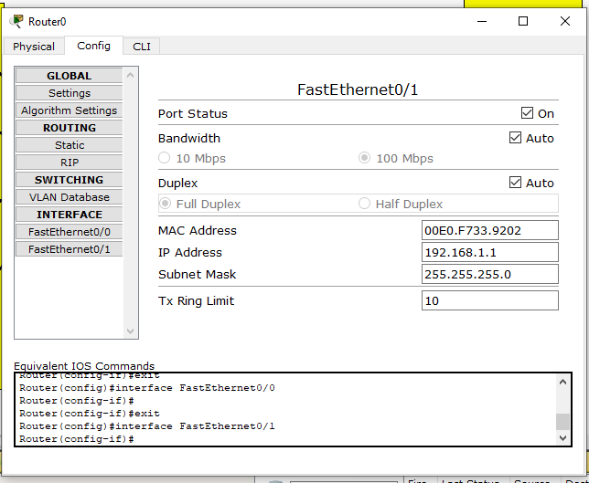

Slide 6
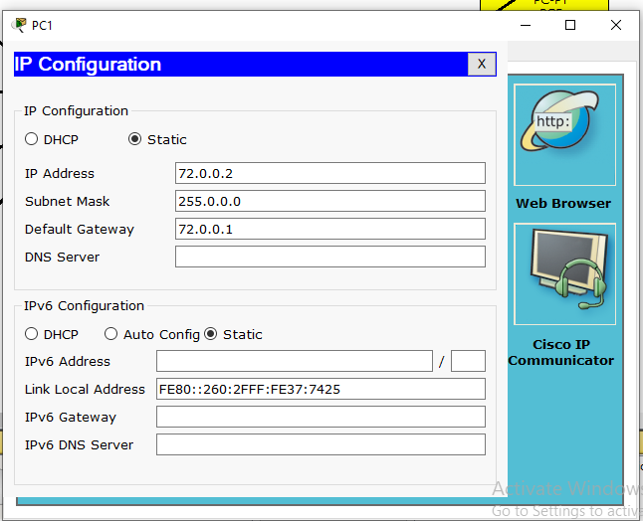

Slide 7
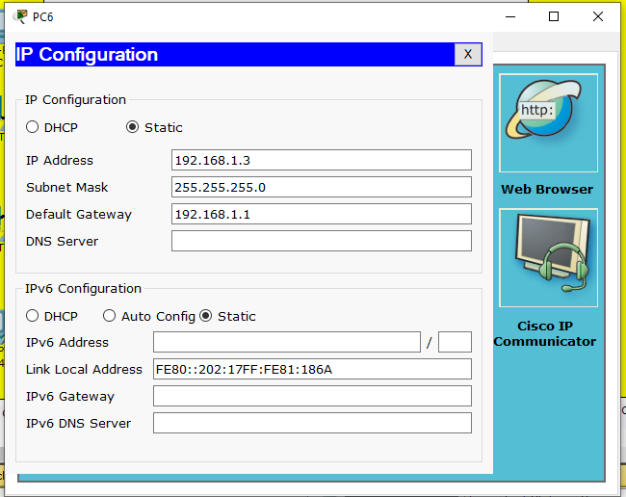

Slide 8


Slide 9
LAB TASK:
Configure 3 LANs using Cisco Packet Tracer. Where each LAN have a different IP Address Class.
Each local area network consist of 5 to 6 systems.
Each LAN has different subnet mask class!
e.g.
LAN1 (Class A)
LAN2 (Class B)
LAN3 (Class C)

